Slide 1


Slide 2
ABOUT US
Name : Tirumalasetty Sai Kiran
Qualification : BE/ B .Tech in Computer Science and Engineering.
Name : Dinesh Reddy Anapana
Qualification : BE/ B .Tech in Mechanical Engineering.
Why Data Science : As world is getting digitized, vast majority of data is being generated every second. Study of this data is getting more and more important. It is completely fascinating so, I choose Data science to shift my career to have a new beginning for long term career.
What you like about INNOMATICS RESEARCH LABS : The first thing I found interesting is mentoring sessions, Where we can reach out our mentors for doubt clarifications. Moreover lectures are very informative and trainers taught from very initial to advance stages.

Slide 3
WEB SCRAPING
Web scraping is used to describe the use of a program or algorithm to extract and process large amounts of data from the web.
It is used to generate leads for marketing .
It focuses on transformation of unstructured data on the web (typically HTML) into structured data that can be stored and analyzed.
This method is mainly used for price comparing and competition monitoring.
Why we scrape? :
Web pages contain wealth of information designed mostly for human consumption.
Static Websites.
Websites are more important than API'S.
No rate Limiting.
Anonymous access.

Slide 4
TABLE OF CONTENT
Technologies /Libraries Used : Steps Involved :
Pandas * Importing necessary Libraries.
Seaborn * Exploring Datasets with Pandas.
Matplotlib * Data Type conversion.
* Uni-Variate Analysis.
* Bi- Variate Analysis.
* Multi-Variate Analysis.
* Problem Statement of Customer.

Slide 5

WEB-SRCAPPING ON
Presented By:
Dinesh Reddy Anapana
Saikiran Tirumalasetty

Slide 6
CARS 24
Cars24 was founded in 2015 by Vikram Chopra, Mehul Agrawal, Gajendra Jangid and Ruchit Agarwal as a platform to buy and sell used cars. In 2021, the company expanded operations internationally in several countries.
The Cars24 platform facilitates the transaction and has an offline presence. Apart from selling used cars, the company's services include paperwork such as transferring the car to the name of the new owner which enables end-to-end transactions and offers an online auction platform to businesses looking to sell their pre-owned cars. In 2019 the company started offering verified used cars where the company offered a buyback guarantee on the vehicles verified by inspection.
The company operates 202 branches across 73 cities in India as of 2019. Apart from its own branches, the company has a tie up with more than 10,000 channel partners across 230 cities in India.
In May 2020 the company launched Cars24 Moto.Cars24 Moto is a service which allows customers to sell used two wheelers such as motorbikes, mopeds and scooters on its platform. It also launched a service offering vehicles inspection services at the customers location in place of their branch.

Slide 7
Use case of Project
USE CASE :
This project is to customer based on their requirements of used cars and we had taken data from website like(Cars24) and giving analysis about all used cars
The dataset contains the complete information of used cars like city wise ,variants of cars, price-analysis, Estimating required kilometer range .
Also helps us to predict the condition of cars in nearby available cities .

Slide 8
WEB SITE
URL = "https://www.cars24.com/buy-used-cars-{}/?itm_source=Cars24Website&itm_medium=sticky_header/page={}"

Slide 9
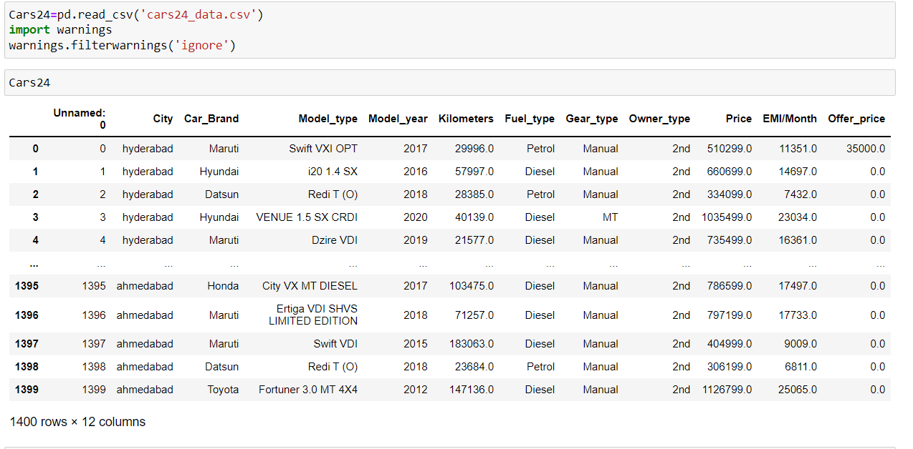
WEB SCRAPING USING THE DATA
Data after cleaning :

Slide 10
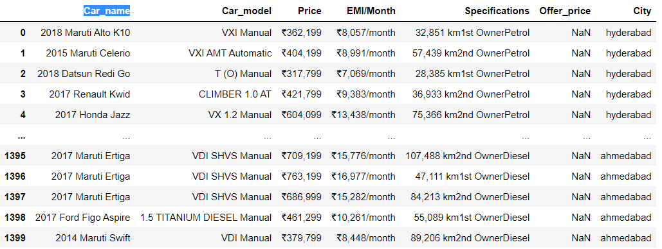
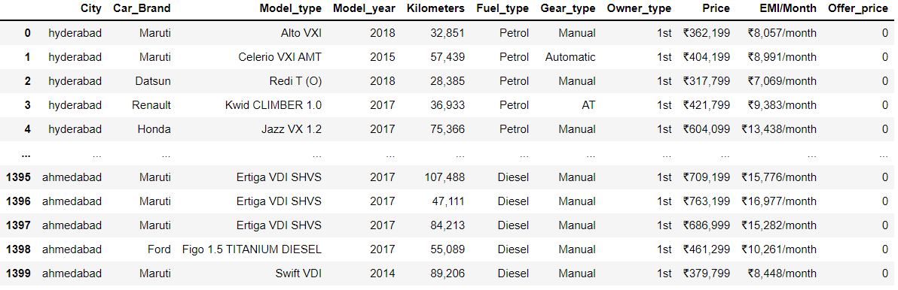
Data Cleaning
Data frame Before Cleaning
Data frame After Cleaning

Slide 11
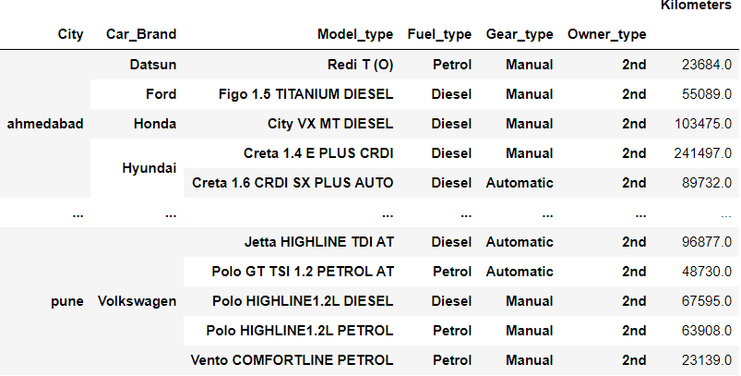
Categorical Data Analysis with Pivot Table

Slide 12
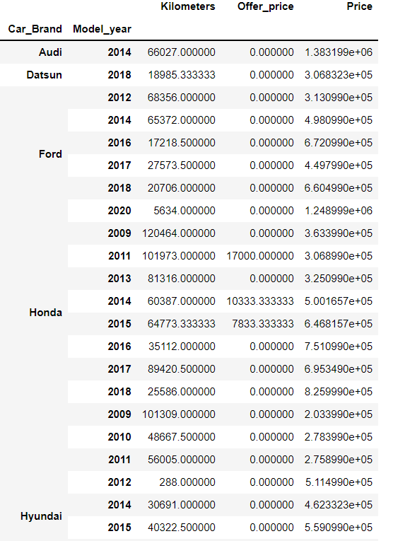
Numerical Data Analysis with Pivot Table

Slide 13
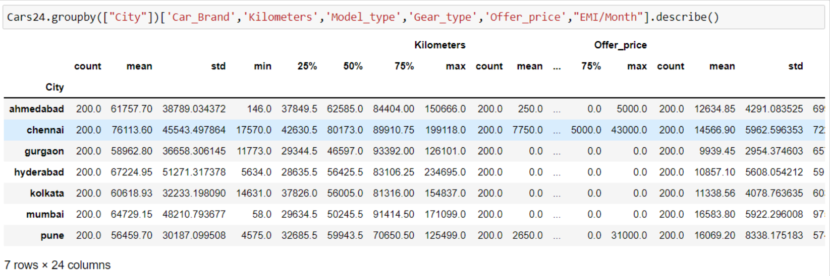
Mean, Median and Standrad Deviation
Here by given data all numerical data analysis as described with describe function
which makes pure analysis of data frame and all numerical data has arrange with “count “,’mean’, “Std” of all kilometers and offer price analysis.
We can grab data easily based on customer requirement

Slide 14
DATA VISUALIZATION
Uni variate analysis :
Analysis of only one variable to summarize the data and find patterns in them.
There are many different ways people use uni variant analysis. The most common uni variant analysis is checking the central tendency (mean, median and mode), the range, the maximum and minimum values, and standard deviation of a variable.
Bi variate analysis :
It involves analysis of two variables for determining then relationship between them.
These variables could be dependent or independent to each other. In Bivariate analysis is that there is always a Y-value for each X-value.
Multi variate analysis :
Analysis multiple variable to find the relationship between them and there relevance to the problem.
For three variables, you can create a 3-D model to study the relationship (also known as tri-variate Analysis). However, since we cannot visualize anything above the third dimension, we often rely on other techniques for us to be able to grasp the relationship in the data.

Slide 15
Uni-Variate Analysis

Slide 16
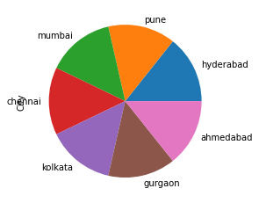
Pieplot with univariate
Here we observed the all contains same number of cars.
All city we have taken metropolitan cities .
Because in metropolitan cities required well as cars due being large distances of destinations.

Slide 17
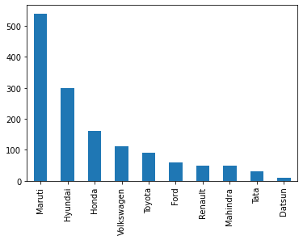
Barplot
Here we observed the all car brand contains maruti cars are high in range.
All cars we have taken in metropolitan cities .
Datsun cars in low in range in all city by car brand.
Hyundai plays mean role in these graph.

Slide 18
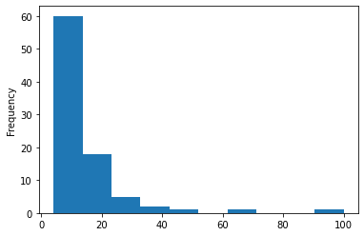
Histplot
Here we observed the all model year contains more than are high in range.
All years are repeated aleast more than 5 times.
Highest year is repeated more than below 60 times.
Hyundai plays mean role in these graph.

Slide 19
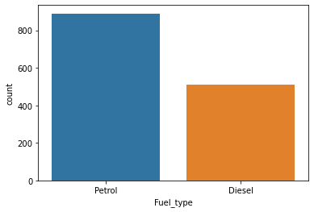
Count plot
Here we observed the all fuel types contains more than are high in range.
In this data we four types of fuel types.
Petrol type is more than diesel in these analysis.
Diesel type plays mean role in these graph among all four types.

Slide 20
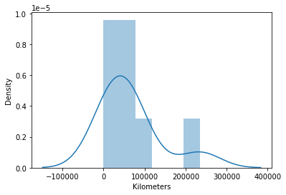
Distplot
Here we observed the kilometers with density points.
Kilometers maintained max range of intervals between zero to 100000 with Density.
It gradually makes mean range intervals in between 100000 to 200000 with Density.
It gradually makes min range intervals in between 200000 to 300000.
.

Slide 21
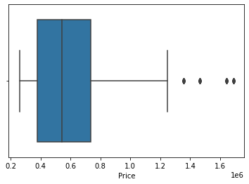
Boxplot
Here we observed the all prices with respective every used cars
Prices of cars are arranged in different cities as mentioned.
Box plot represents than less and mean part of prices which have in data.
Black dots are represents as “outliers” in these graphs.

Slide 22
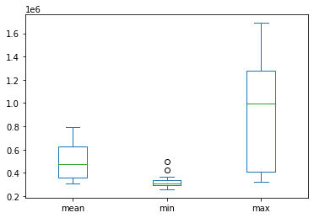
Box plot
Here we observed individual model years has different prices also, they described by max,mean,min values through Box plot.

Slide 23
Bi-Variate Analysis

Slide 24
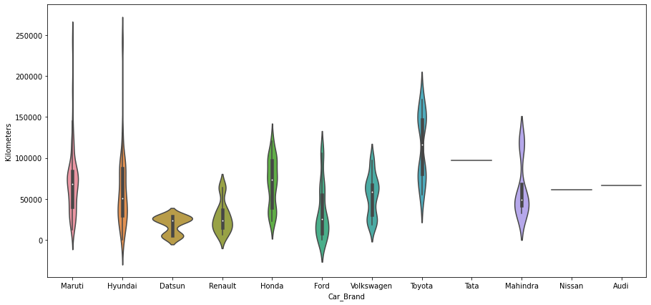
Violin plot
Here cars differs by car brand and price through Violin plot, result has given like Toyota is highest price holder.
Here analysis done at between carbrand and kilometers

Slide 25
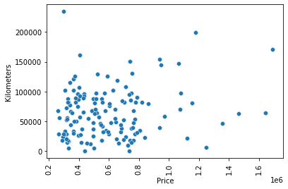
Scatter plot
Here we observed spots of collision of price and Kilometers, It differs all price factors of kilometers in Blue spots through 'Scatter_plot'.
Analysis on Price and Kilometers

Slide 26
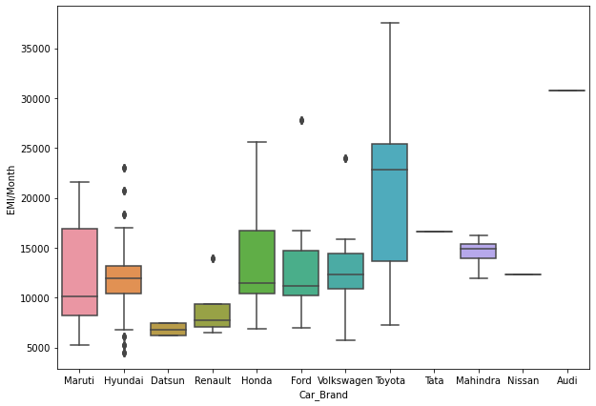
Boxplot on Car Brands
Boxplot used for showing difference and analysis of every Car Brand and EMI/Month values.
TOYOTA grabs highest place in this analysis,
DATSUN grabs least place in this analysis.

Slide 27
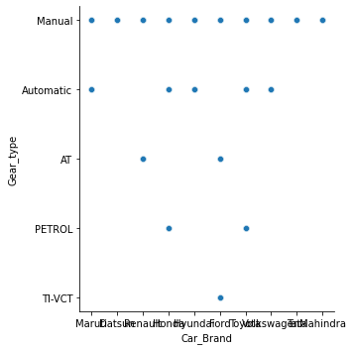
Relationship plot
Gear type observations done at four types of Gear types Based on Car Brand through “Relationship plot".
Analysis on car brand and Gear type.

Slide 28
Multivariate Analysis

Slide 29
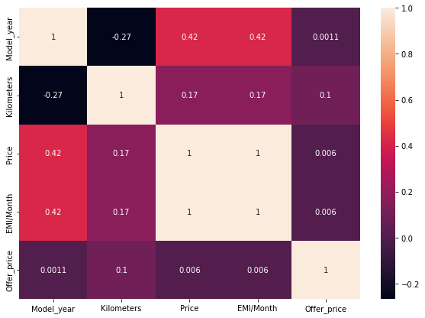
HeatMap Analysis on Corelation
The heatmap colors plot below uses random data again. This time it’s using a different color map (cmap), with the ‘light pink’, which as nothing but colors of pink and dark violet. It also uses square blocks.

Slide 30
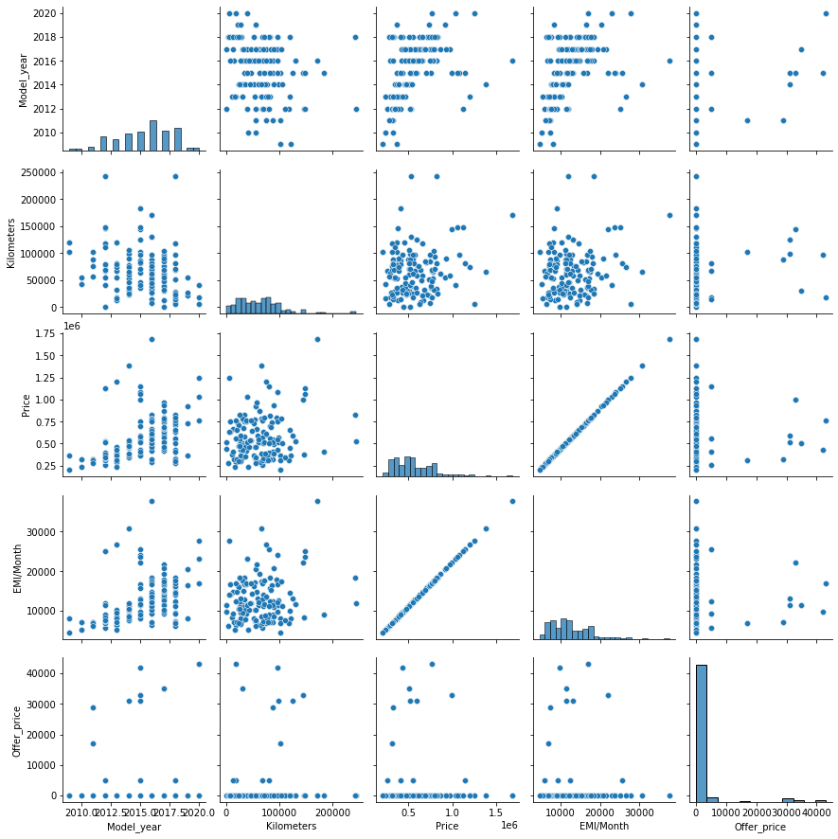
Pair plot of Cars24
Pair plot is used for diffrence visualization, because the measurements and classes (CARS) provide an excellent way to distinguish classes. The data is mapped in the grid below. Because there are 4 measurements, it creates a 4x4 plot.

Slide 31
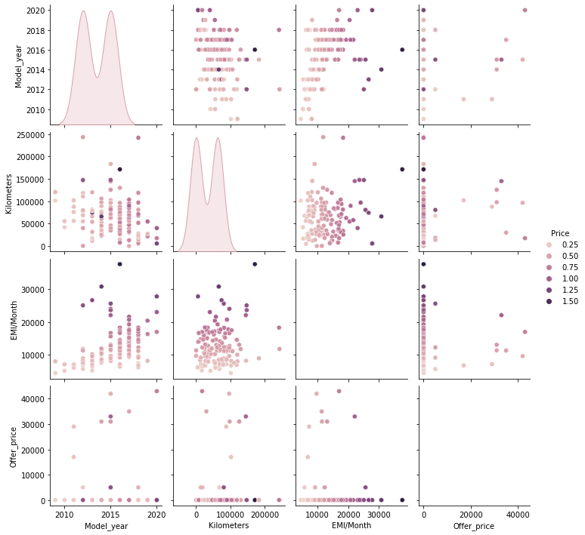
All plots with hue (‘price’)
Pair plot is used for diffrence visualization, because the cars and price(modelyear,kilometers,EMI/Month) provide an excellent way to distinguish classes. The data is mapped in the grid below. Because there are 4 measurements, It creates a 4x4 plot.

Slide 32
Problem Statement of Customer
CUSTOMER SEARCHING FOR USED CARS BELOW 250000/- IN BEST CONDITION.
Searching for used cars for price below 250000/-
Next followed data has filter with different analysis like
Year of model.
How many specified cars in certain geartype?
Which fuel type are specified for that cars?
How many kilometers completed for every car with customer requirements.
Price analysis on each car by price, EMIprice,OFFER PRICE.

Slide 33
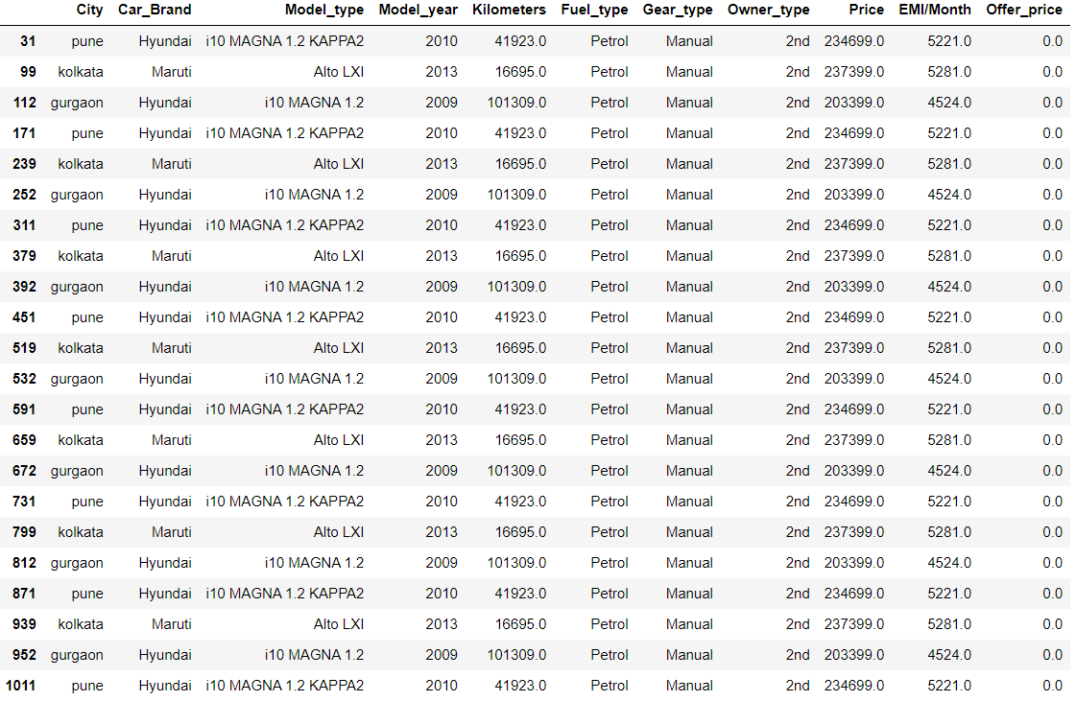
CUSTOMER SEARCHING FOR USED CARS BELOW 250000/- IN BESCONDITION

Slide 34
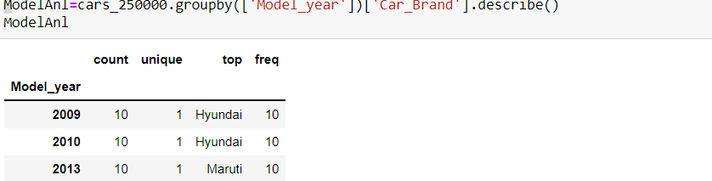
Analysis on Year of model
Here we observed certain car brand having some model-years on making of analysis we got highest number of Hyundai cars on years 2009,2010.

Slide 35
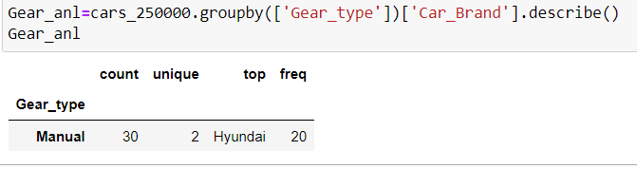
How many specified cars in certain gear type?
Here we observed certain car brand having some gear types on making of analysis we got highest number of Hyundai cars on manual .

Slide 36
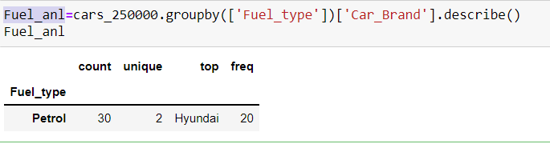
Which fuel type are specified for that cars?
Here we observed certain car brand having some fuel types on making of analysis we got highest number of Hyundai cars with pertol.

Slide 37
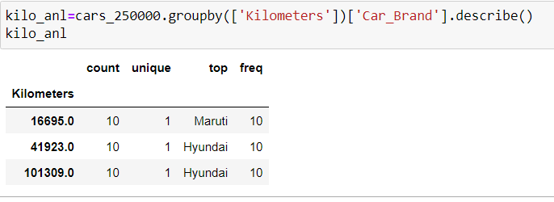
How many kilometers completed for every car with Customer Requirements.
Here we observed which car completes minimum kilometers on making of analysis we got highest number of Hyundai cars with 16695kms.
Here we observed which car completes maximum kilometers on making of analysis we got highest number of Hyundai cars with 101309kms.

Slide 38
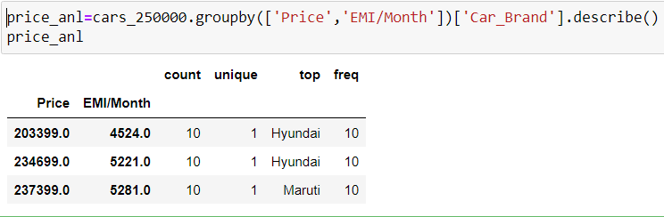
Price analysis on each car by Price, EMI/Price,Offer Price.
Here we observed minimum price variance on car brand on making of analysis we got low price of highest number of Hyundai cars with Emi price low amount of RS.4524/month.
2.Here we observed maximum price variance on car brand on making of analysis we got high price of highest number of Maruti cars with Emi price high amount of RS.5281/month

Slide 39
Conclusion
Based on application or website we analyzed which used cars can have all information about an entity ,while doing analysis on these project data has placed in different class for more user interface but it makes the good environment to end user but process of data cleaning, we faced so many problems like nan values and special characters and different variants in cars like scenarios.
That make sense by grabbing these type of data from web we can learn cleaning techniques very sure .By the way after cleaning we got analysis part in that stage we learn about how to analyze a data in different variants and by visualizations like using some what graphs,Totally these data will uses to who are trying to buy best used cars in big cities with out any external stress ,through their laptops are mobiles.
But we observed that we want more exposure of data placed in website, which makes good interface to customer and mean while it gives good growth to organization to makes best results.

Slide 40


